Slide 1

Air Canvas
Team Python thinkers

Slide 2

Team Members
Anto Francis (C0825095)
Omer Volkan Guney (C0831373)
Rupesh Chandran (C0826779)
Sachin Sreekumar (C0825096)
Reporting Week: Feb 5, 2022 to Feb 12, 2022
Supervised by
Prof. Parissa Naraei

Slide 3
Week’s update
Get Jira and Slack ready for project management and internal communication
Air Canvas project Github repository is created .All project related documents,weekly reports,presentations added under this repository
Pycharm IDE (Through Anaconda Navigator )has been used in order to establish necessary library/packages.In that way coding is initiated.

Slide 4
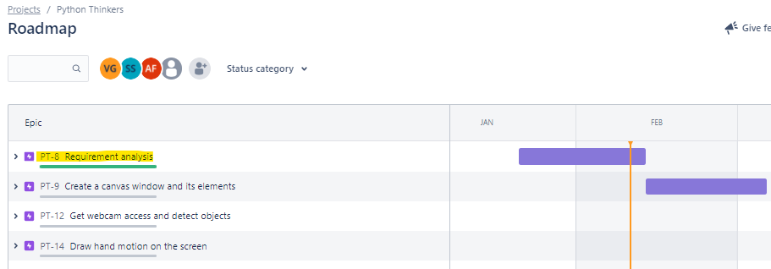
Week’s update
The planning phase of project is now completed which was earlier determined as between 22/JAN - 12/FEB on Jira project management tool.
Another project milestone (Creating the Canvas) has been initiated that is estimated to take around a month to accomplish.

Slide 5
Challenges/Learnings this week
Getting familiarized with usage of Jira and Slack
Installing-Usage of necessary Python Libraries & getting insights out of them

Slide 6
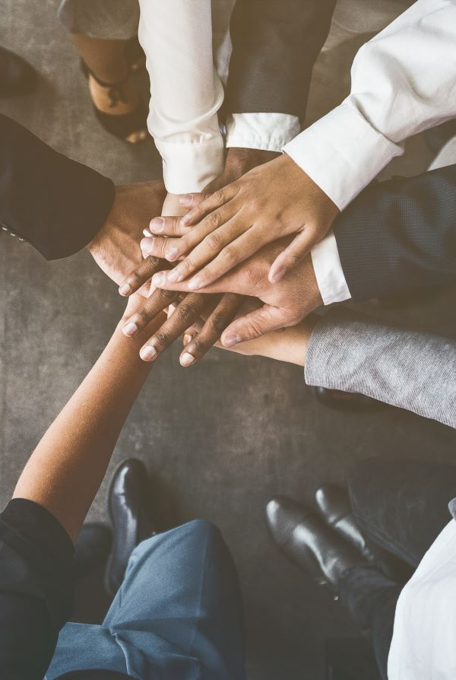
Team collaboration
We have made decisions about the subtask for the second stage of the Project (Creating Canvas UI) we will be using
Assigned individual tasks and decided the duration of each tasks
The tasks which have been identified in previous week is achived by each team individual by following the deadlines on Jira.

Slide 7
Task outline for next week
Beginning of the second stage of the project
Canvas creation
Creating ink buttons on the canvas
Giving different arrays to handle colour points of different colour

Slide 8

Thank you

